Slide 1



Boston Crime Incident Report Dashboard
By: Xiaotong Ma, Szuyun Hao, John DiSessa, and Tomo Yoshii

Slide 2

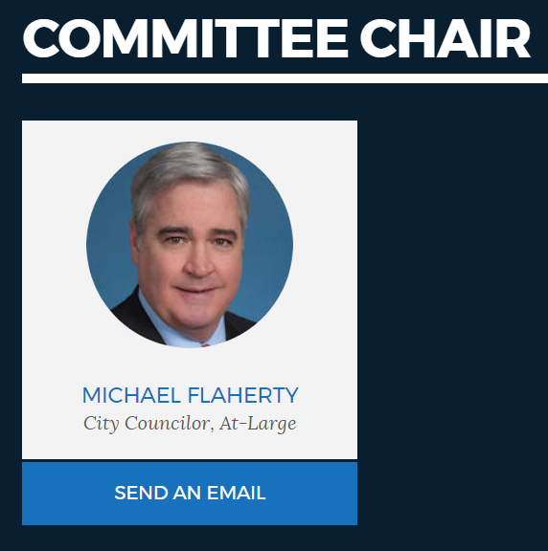
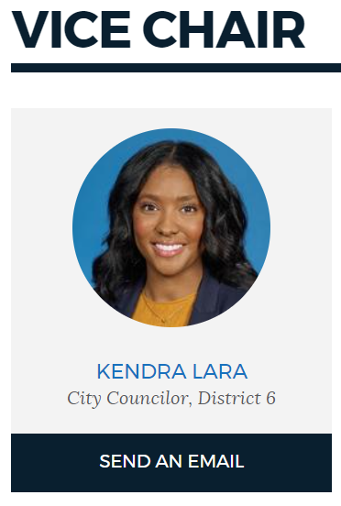
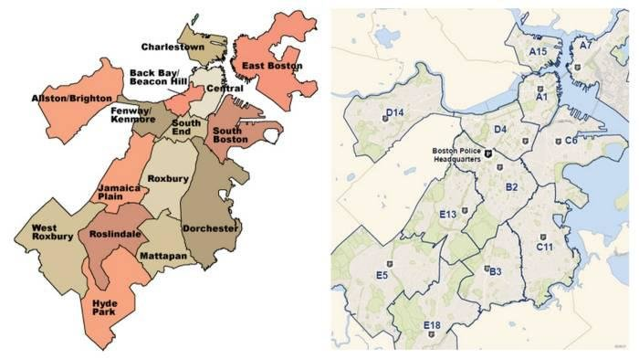
Introduction
Public Safety and Criminal Justice Committee
Michael Flaherty (Chair)
Kendra Lara (Vice-Chair)
Interactive Data Dashboard Display
Police, Fire, First Responders (all reported incidents)
District, incident type, frequency trends
Boston.gov Annual Crime Incident Report
2015 – 2020

Slide 3
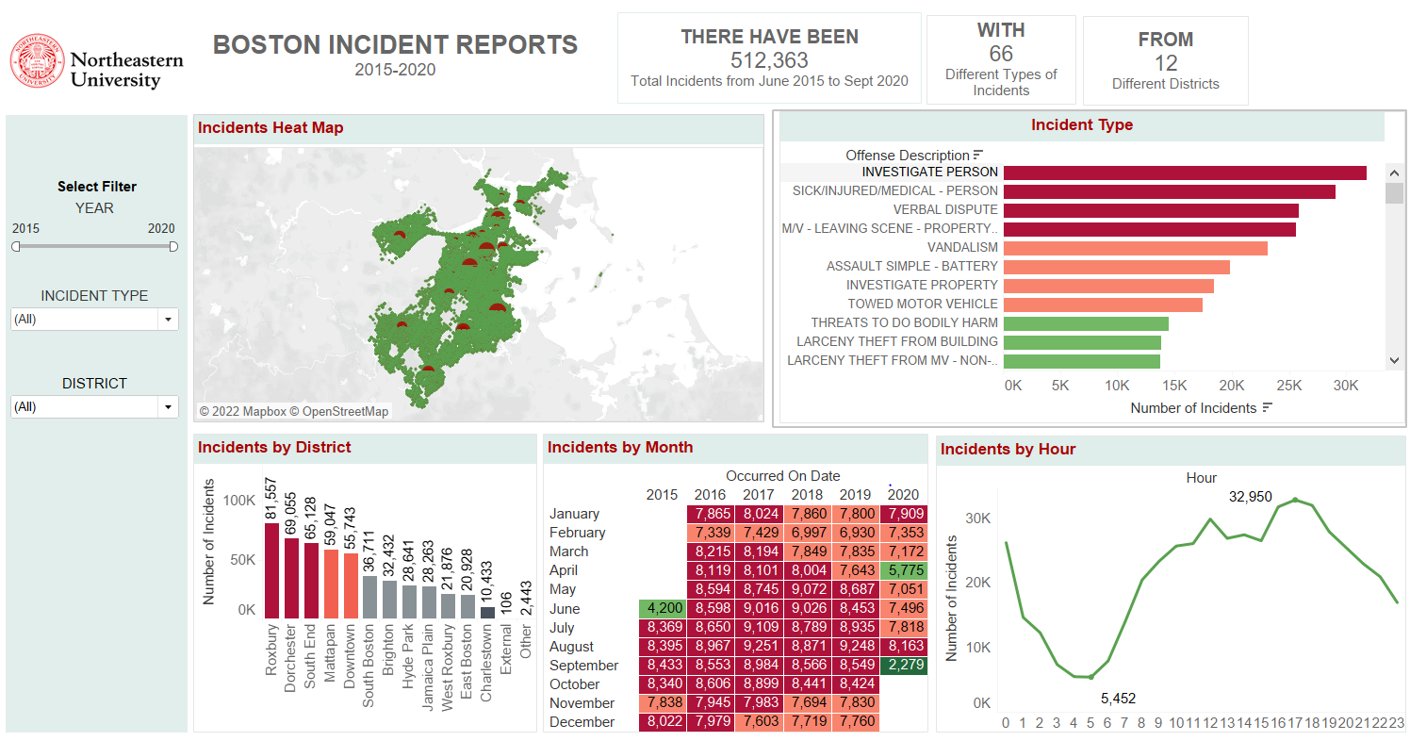
Boston Incident Report Dashboard

Slide 4
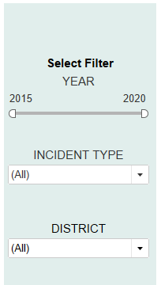
Labels & Filters
All data from 2015 – 2020
Live dashboard filtering
Instantly view any subset of data

Slide 5
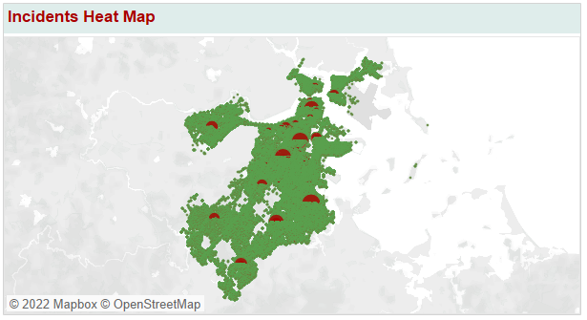

Crime Incidents Regional Distribution Map
Gibson Street
Most severe street
Green Dots
Low frequency of incidents
Red Dots
High frequency of incidents

Slide 6
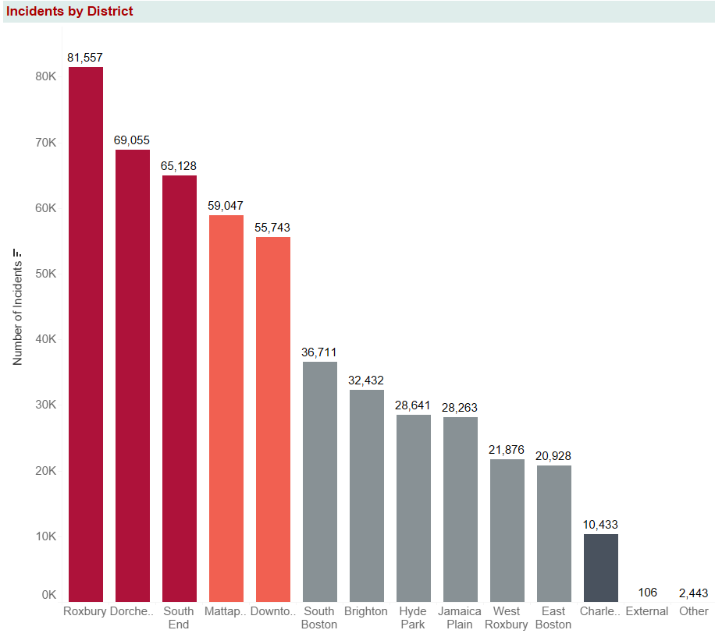
District Incidents
Roxbury
Most severe district
Charleston
Least severe district
Suggestions
Increase police presence in Roxbury, Dorchester, and South End districts
Legal literacy classes
Police DEI education

Slide 7
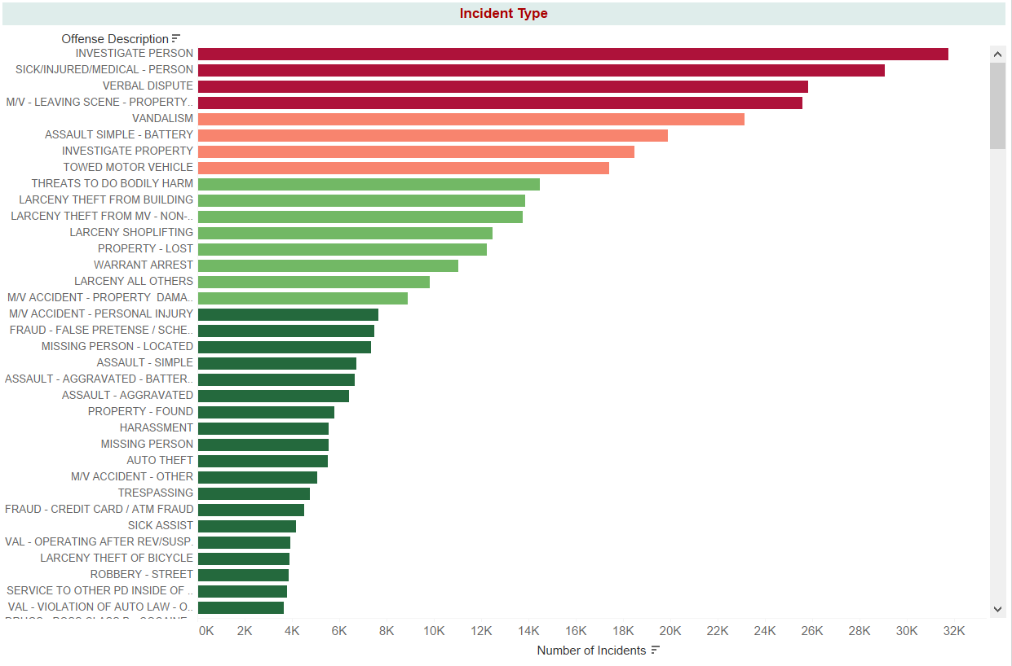
Incident Types
Top 3 Incidents
Investigations, sick/injured/medical, verbal disputes
Motor Vehicle Incidents
Largest subgroup
Many incidents involve a motor vehicle
Suggestions
Promote legal knowledge
Improve city driving conditions

Slide 8


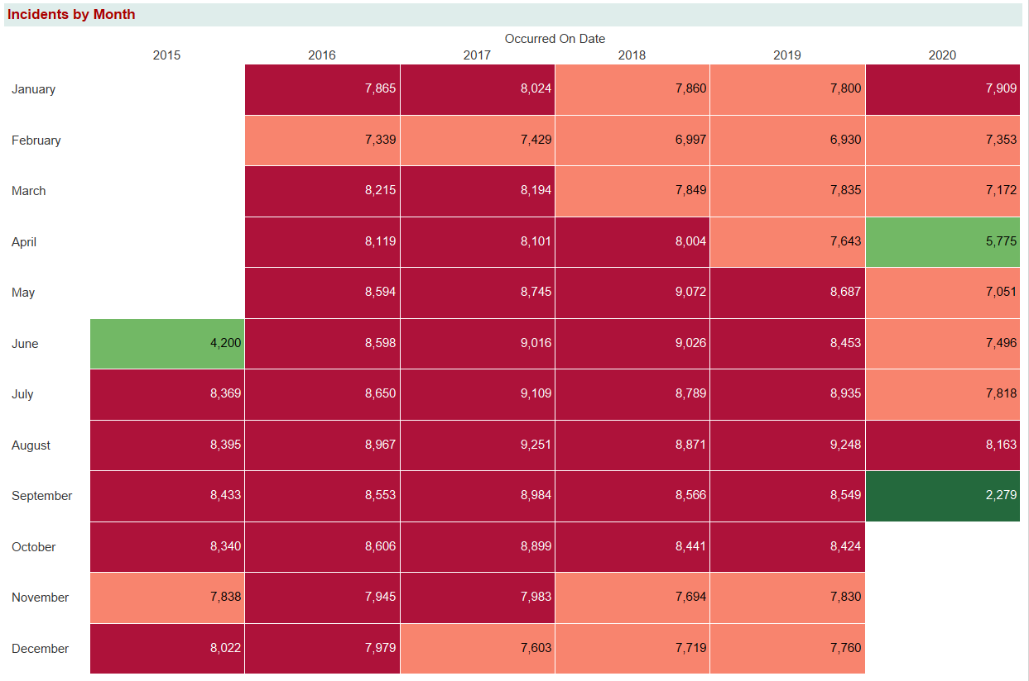
Monthly Incidents
Red: Severe
Green: Acceptable
Incidents decrease throughout the year
August
Most severe month
Suggestion
Increase the frequency of delivery of public safety programs in August

Slide 9
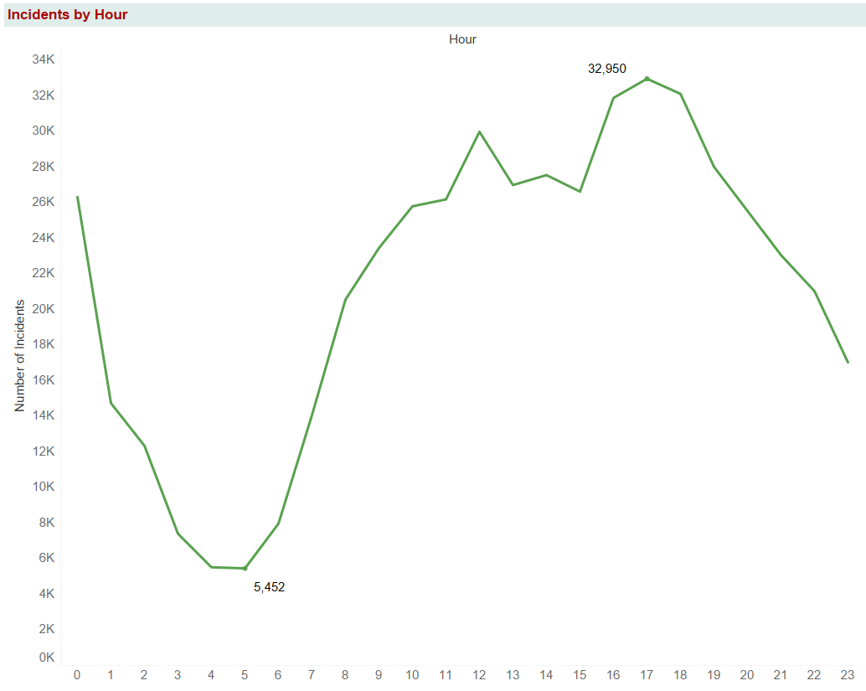
Incidents by Hour
Most incidents between 11am – 7pm
Rush hour traffic
Least incidents between 3am – 6am
Suggestion
Implement better traffic laws

Slide 10
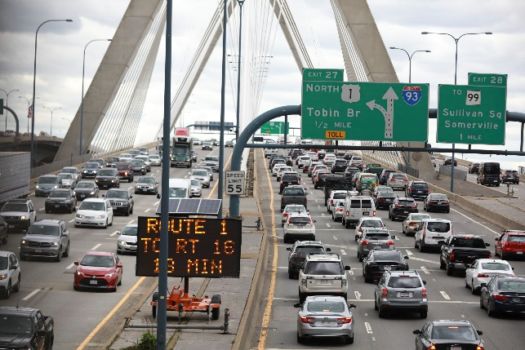

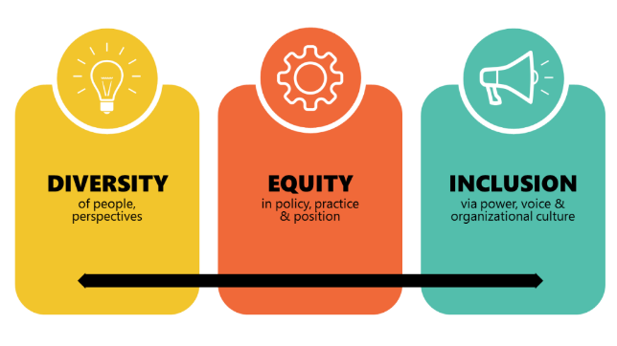
Conclusion
Improve driving conditions
Increase police presence in high frequency areas and times
Remove polices that unfairly discriminate against people of color
Hold police more accountable
Legal literacy classes

